Slide 1
Course Intro 462 - Developing Health Information Systems
W1
👋
Hants Williams, PhD, RN

Slide 2
Concentration
Health Informatics Spring 2021
HAN 462 - Developing Health Information Systems
HAN 466 - Applied Health Informatics
HAN 467 - Utilization and outcomes
HAN 464 - Systems Management

Slide 3
Agenda
Intros -
Course and Syllabi
HIS

Slide 4
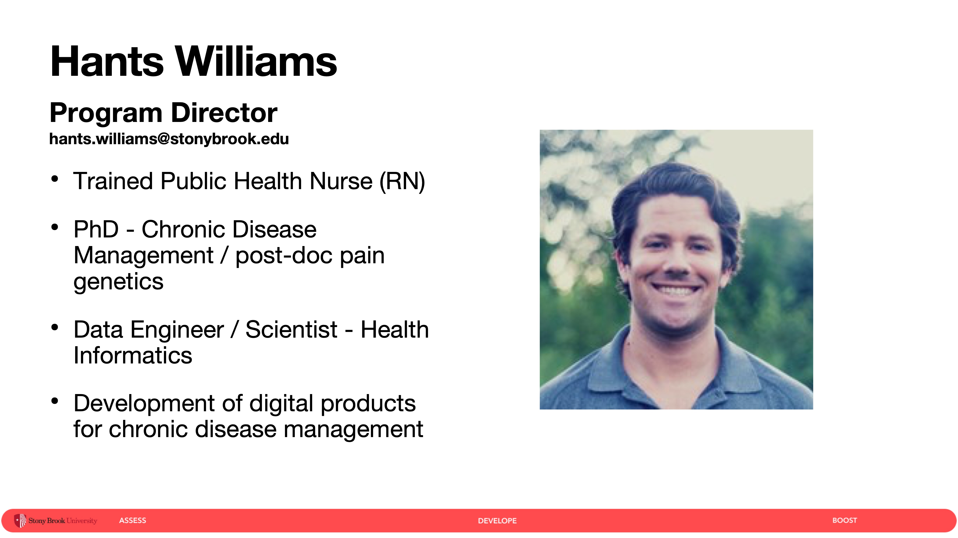

Slide 5

Journey
Clinician ->
Researcher ->
Health/Data SME ->
Data Engineer/Developer ->
Investments ->

Slide 6
Interesting things built recently:
SDoH resources v1 - external community ([Inclusion](https://inclusion.appliedhealthinformatics.com/
SDoH resources v2 - internal SBM ([SDoH](https://sdoh.ahi-projects.com
Data discovery tool - external ([Discover](https://discover.appliedhealthinformatics.com/

Slide 7
This class….
Syllabi / starting class with ‘interesting things’…
Assignment of interesting things

Slide 8

Brightspace
Recordings

Slide 9
How many people have jobs lined up? 🤔

Slide 10
Jobs
- Graduation Timeline**
- T-minus 4 months till graduation; job search can take 3-6 months on average.
- Average job search duration - https://www.washington.edu/doit/what-can-students-do-improve-their-chances-finding-employment-after-college#:~:text=The%20fact%20is%20that%20approximately,to%20secure%20employment%20after%20graduation

Slide 11
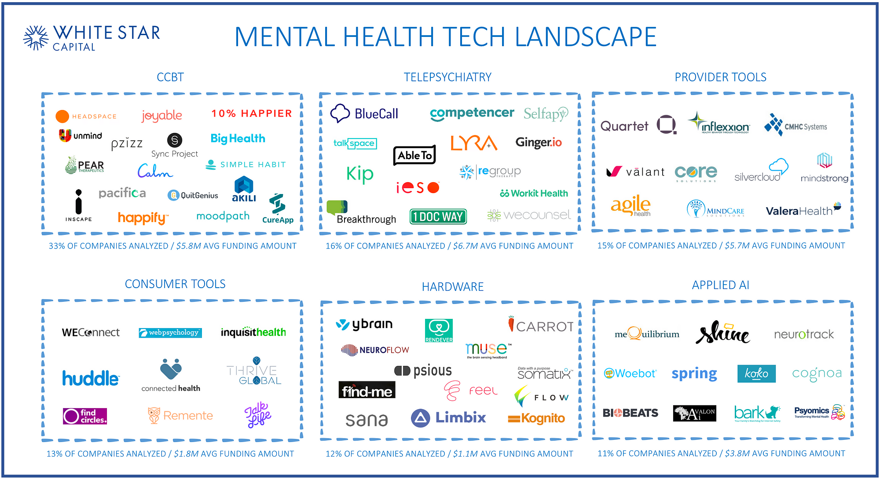
Market Maps for Job Searching
Google images for: “mental health market map”

Slide 12
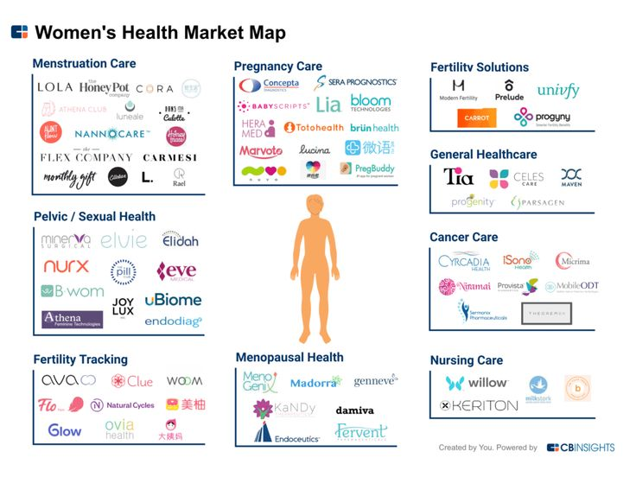
Market Maps for Job Searching
Google images for: “womens health market map”

Slide 13
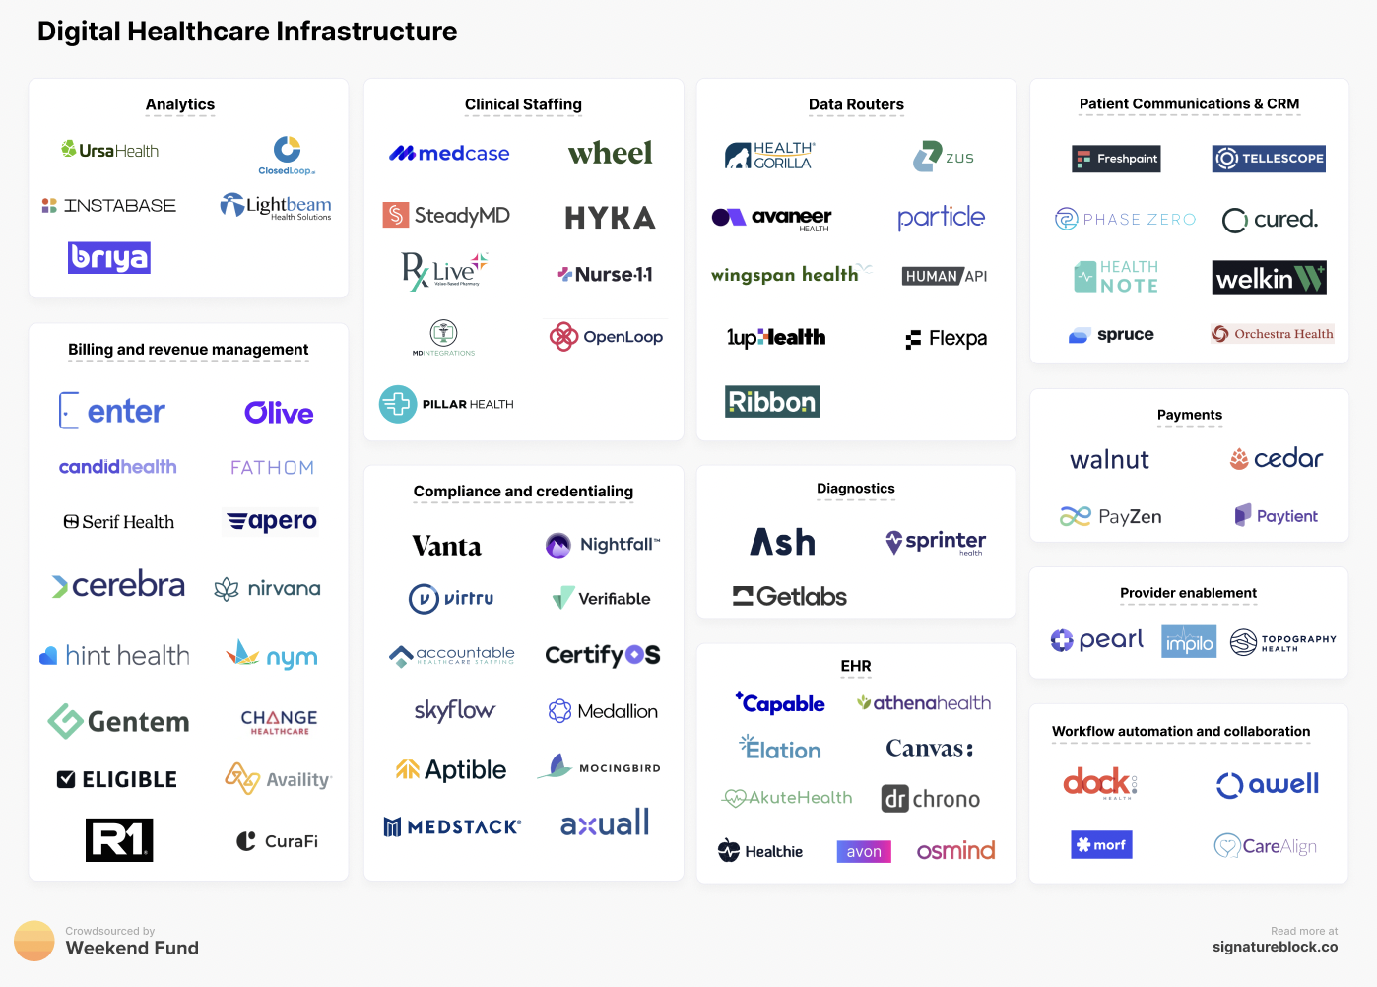
Market Maps for Job Searching
Google images for: “digital health market map”

Slide 14
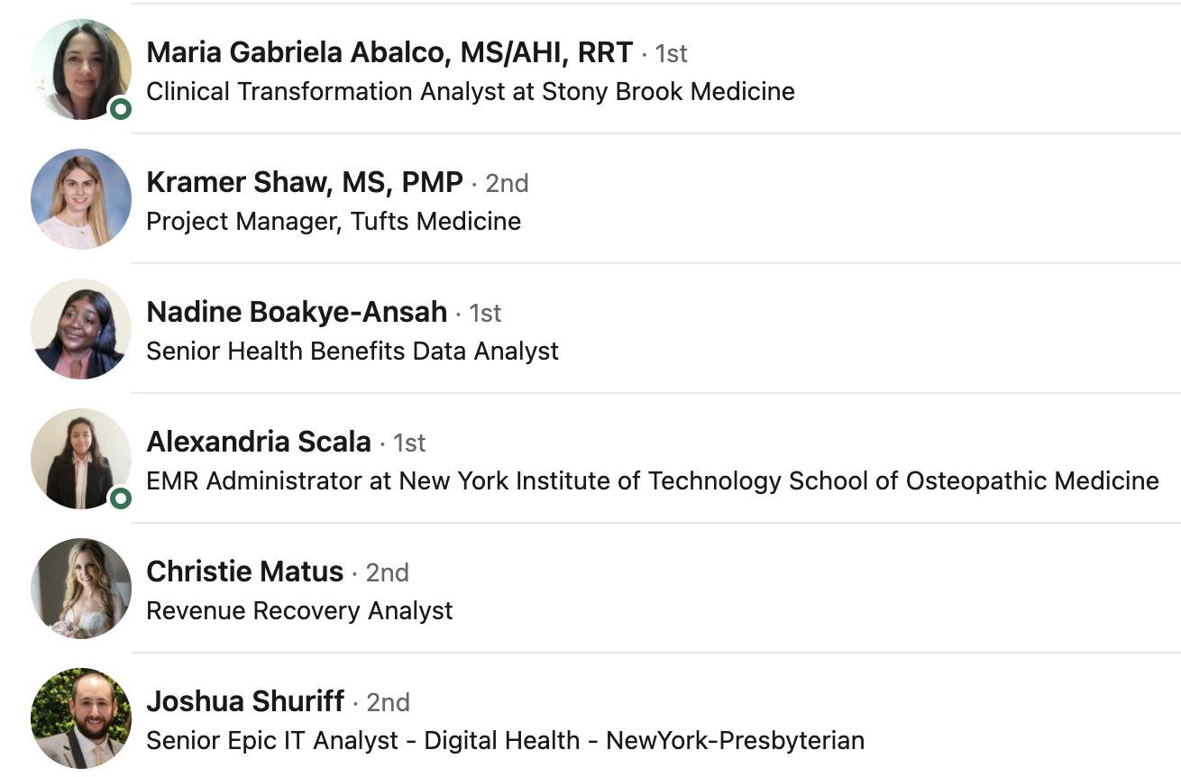
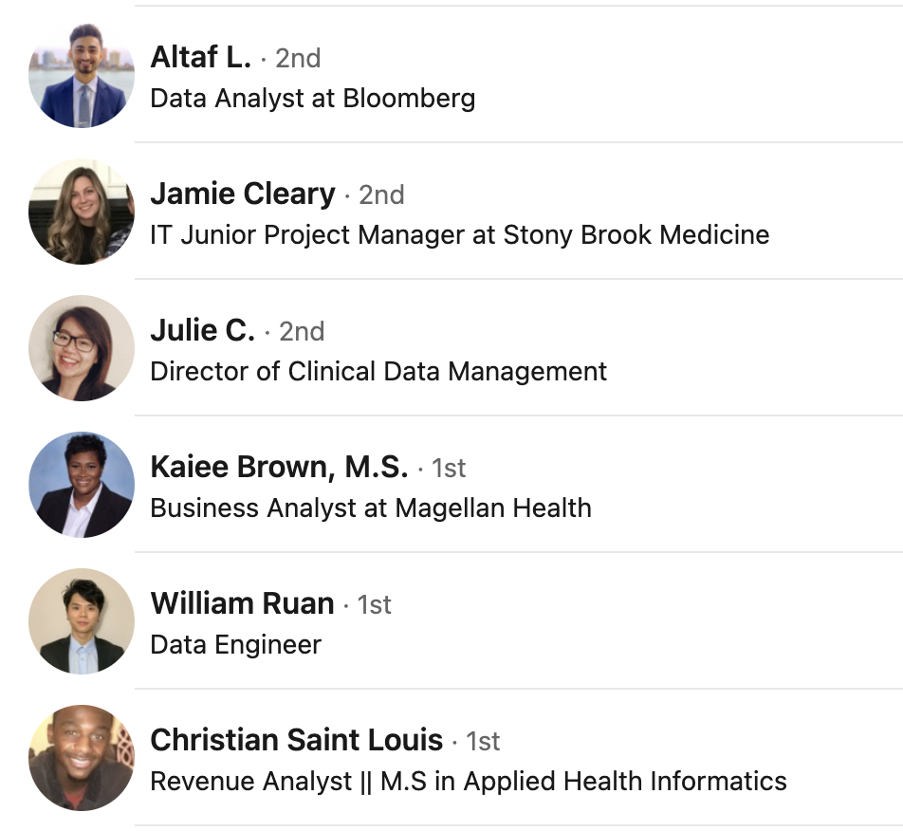
AHI Masters Program
- Two tracks: Data and Project Management
- AHI, 15-month program - accepting applications for Summer 2024
-https://healthprofessions.stonybrookmedicine.edu/programs/ahi
- Past Graduatuates:
https://www.linkedin.com/groups/8582449/members/

Slide 15



Slide 16
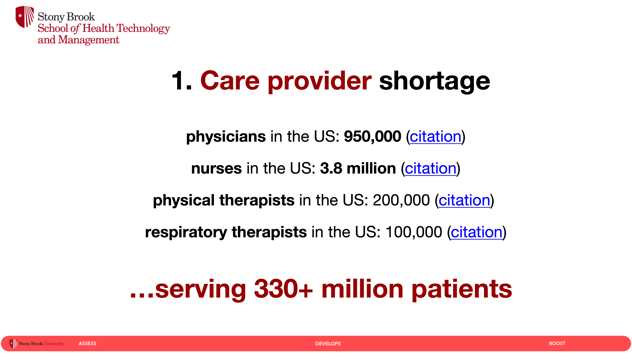

Slide 17
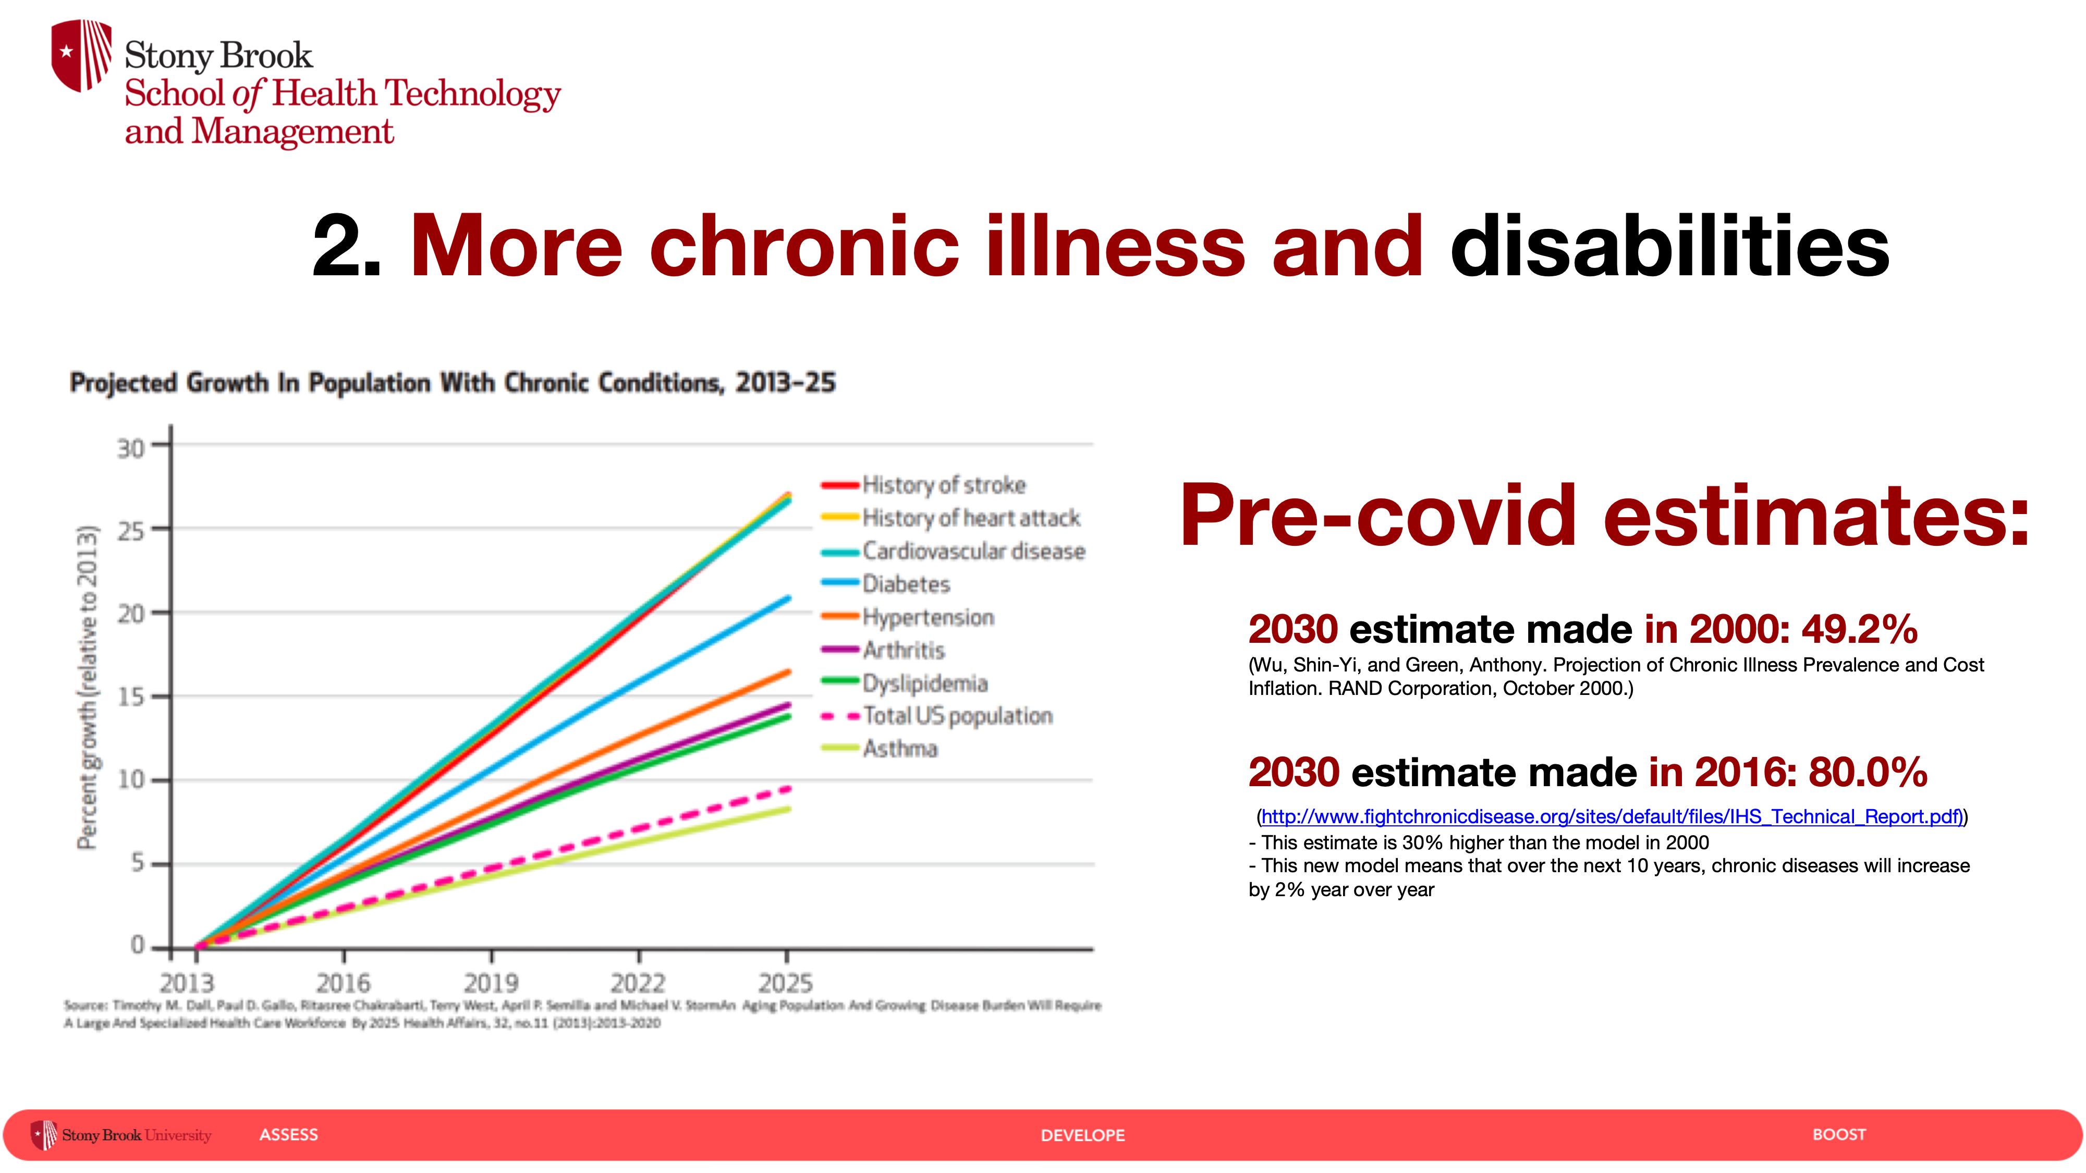

Slide 18
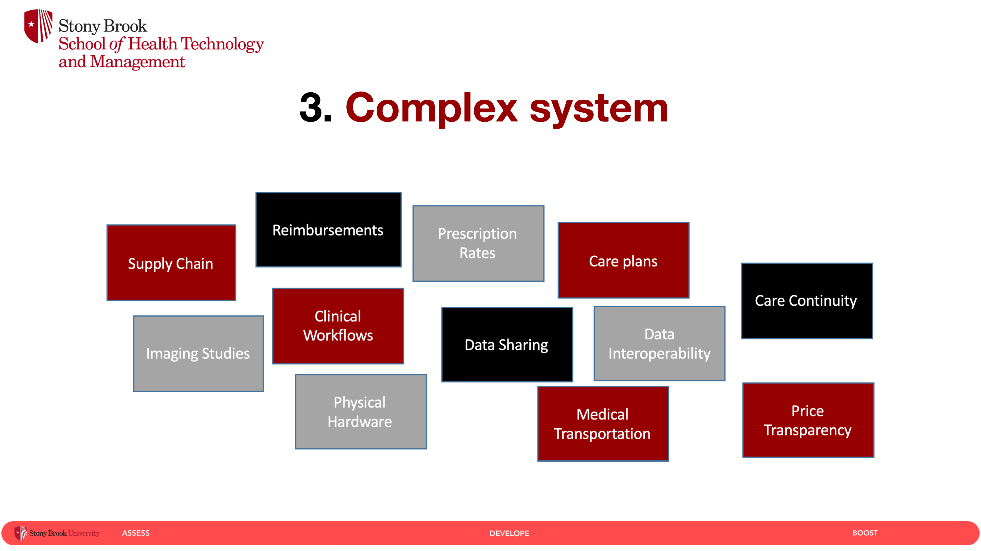

Slide 19
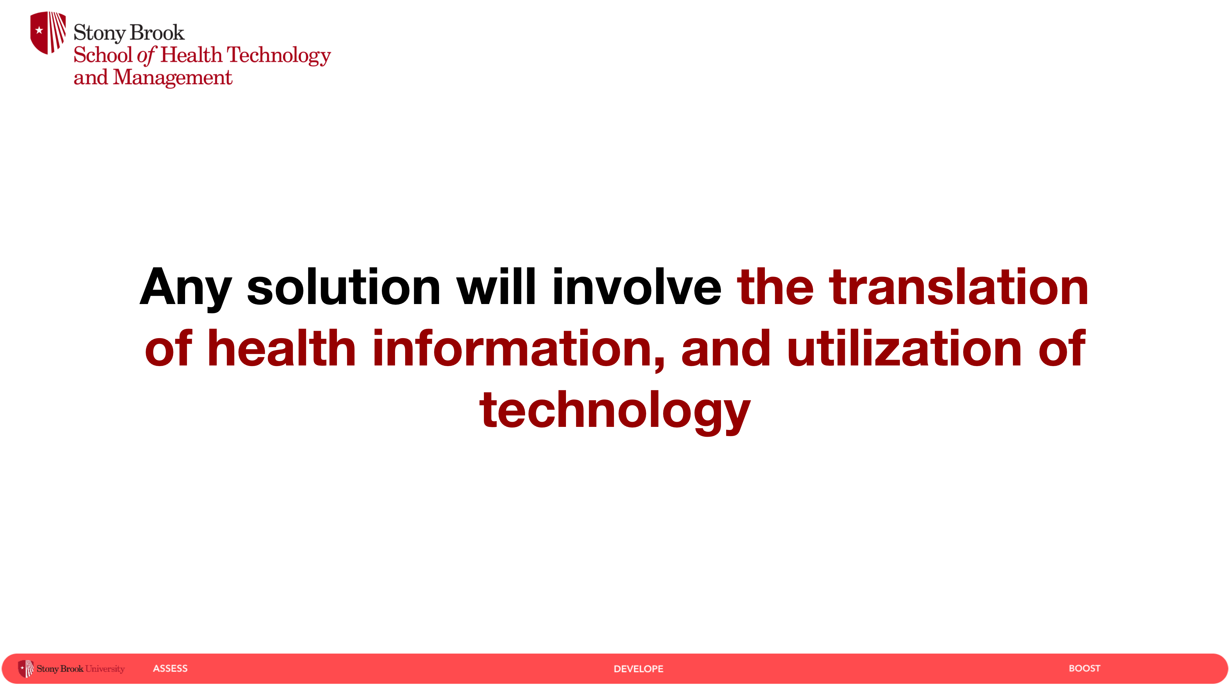

Slide 20
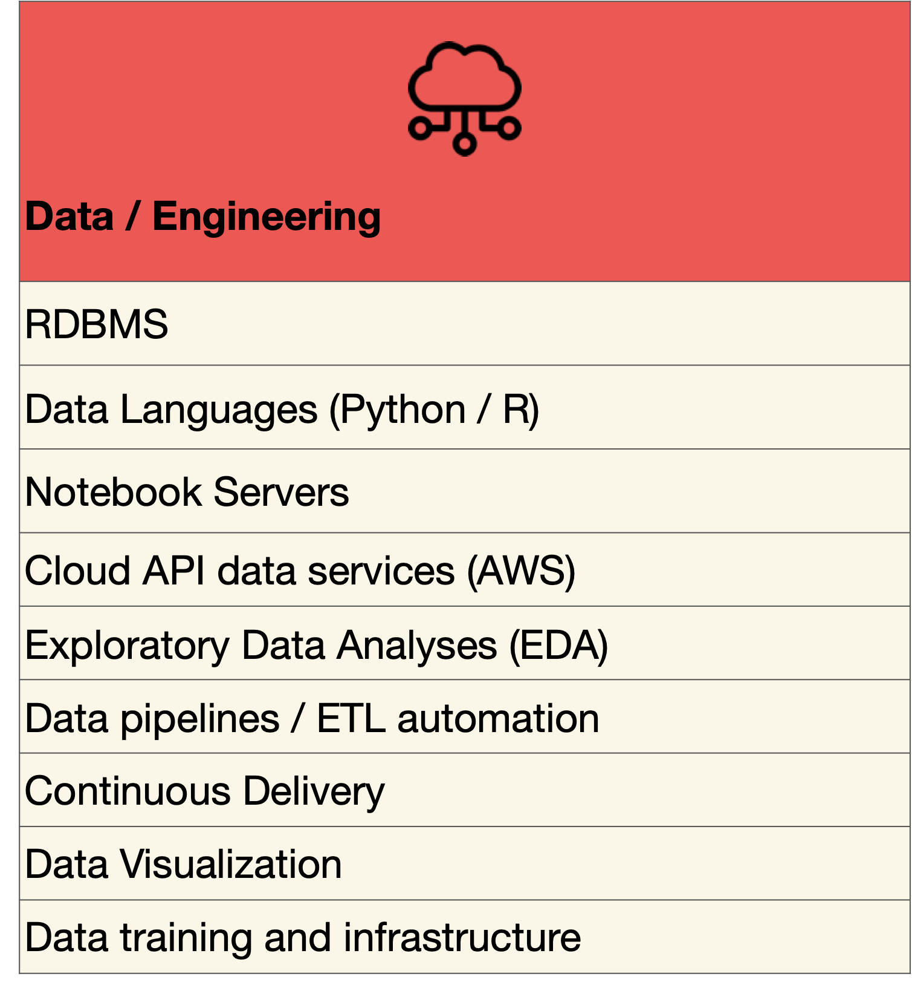
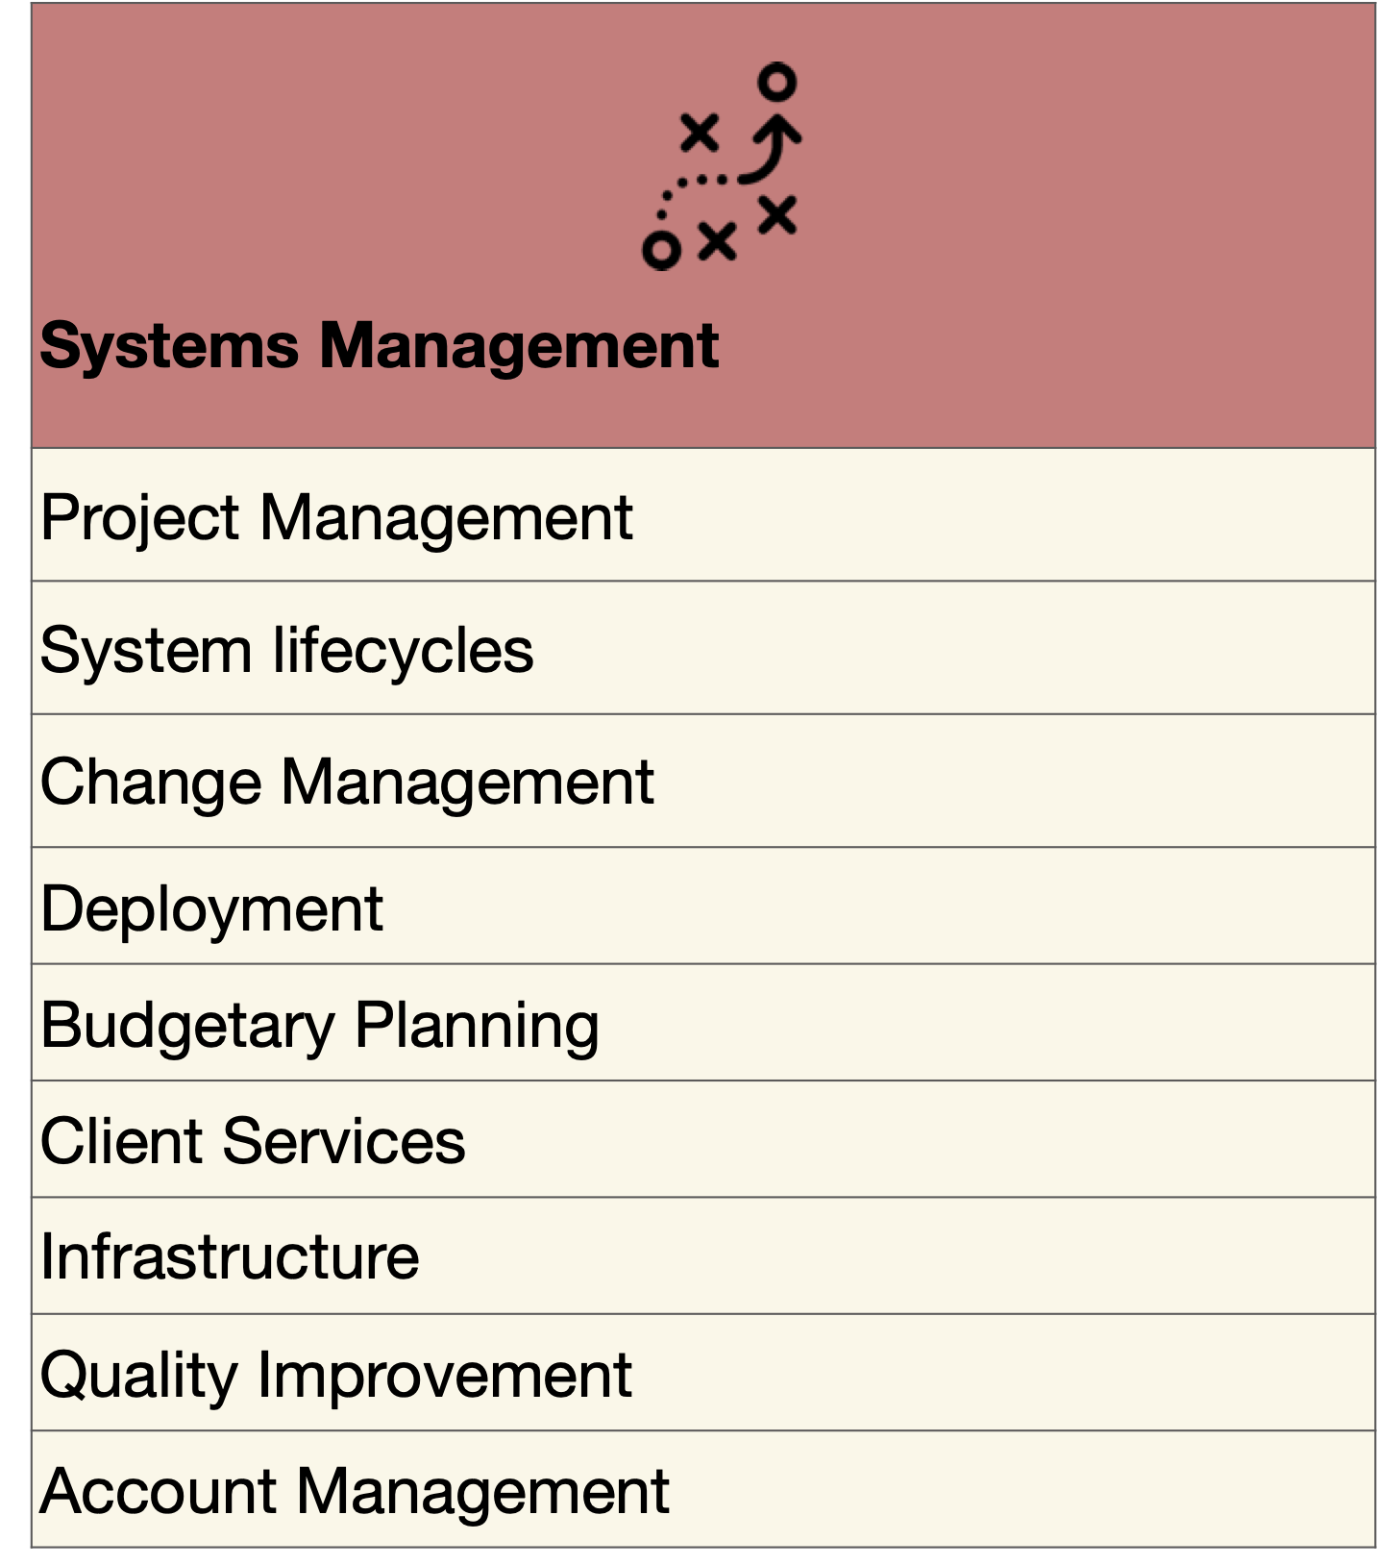

Slide 21
Basic Definitions
## Basic Definitions
- American Medication Informatics Association (AMIA)
- AMIA Definitions
- Health Informatics: the science of using data, information, and knowledge to improve human health and healthcare services.
- HIM: acquiring, analyzing, and protecting medical information; a mix of business, science, and IT.
- NCBI Article: (https://www.ncbi.nlm.nih.gov/pmc/articles/PMC8649705/)

Slide 23
Health information systems

Slide 24
{HIS} revolved around the three P’s // primary stakeholders of care
…main verticals of healthcare

Slide 25
https://medium.com/@geoffreychaiken/the-key-to-better-healthcare-patient-power-5b371d4c2aa0

Slide 26
Needs?
Needs?
Needs?

Slide 27
## Operating Landscape
- Hospitals
- Insurance (payers)
- Pharma(biotech)
- Tech/Vendors
- Consulting

Slide 28
Financial Functions
## Components
Accounts Receivable (AR)
Auto Safety Incident Surv Track System (ASISTS)
Automated Information Collection System (AICS)
Automated Medical Information Exchange (AMIE)
Clinical Monitoring System Integrated Billing (IB)
Compensation Pension Record Interchange (CAPRI)
Current Procedural Terminology (CPT) Library
Decision Support System (DSS) Extracts
Diagnostic Related Group (DRG) Grouper
Electronic Claims Management Engine (ECME)
Engineering (AEMS / MERS) Police and Security
Enrollment Application System Quality Management Integration Module
Equipment / Turn-In Request
Event Capture Release of Information (ROI) Manager
Fee Basis
Fugitive Felon Program (FFP)
Generic Code Sheet (GCS)
Health Eligibility Center (HEC)
Hospital Inquiry (HINQ)
ICD-9-CM
Incident Reporting
Income Verification Match (IVM)
Integrated Patient Funds
Occurrence Screen
Patient Representative
Personnel and Accounting Integrated Data (PAID)
Record Tracking
Veterans Identification Card (VIC/PICS)
Voluntary Service System (VSS)
WebHR
Wounded Injured and Ill Warriors
Clinical Functions
Mobile Electronic Documentation (MED)
Nationwide Health Information Network Adapter (NHIN)
Nursing
Nutrition and Food Service (NFS)
Oncology
Patient Appointment Info. Transmission (PAIT)
Patient Assessment Documentation Package (PADP)
Patient Care Encounter (PCE)
Patient Record Flags
Pharm: Automatic Replenish / Ward Stock (AR/WS)
Pharm: Bar Code Medication Administration (BCMA)
Pharm: Benefits Management (PBM)
Pharm: Consolidated Mail Outpatient Pharmacy
Pharm: Consolidated Mail Outpatient Pharmacy
Pharm: Controlled Substances
Pharm: Data Management (PDM)
Pharm: Drug Accountability
Pharm: Inpatient Medications
Pharm: Outpatient Pharmacy
Pharm: Prescription Practices (PPP)
Prosthetics
Quality Audiology and Speech Analysis and Reporting (QUASAR)
Radiology / Nuclear Medicine
RAI/MDS
Remote Order Entry System (ROES)
Social Work
Spinal Cord Dysfunction
Standards & Terminology Services (STS)
Surgery
Traumatic Brain Injury (TBI)
Virtual Patient Record
VistA Imaging System
VistAWeb
Visual Impairment Service Team (VIST)
Vitals / Measurements
Women's Health
Admission Discharge Transfer (ADT)
Ambulatory Care Reporting
Anticoagulation Management Tool (AMT)
Automated Service Connected Designation (ASCD)
Beneficiary Travel
Blind Rehabilitation
Care Management
Clinical Case Registries
Clinical Procedures
Clinical/Health Data Repository (CHDR)
Computerized Patient Record System (CPRS)
CPRS: Adverse Reaction Tracking (ART)
CPRS: Authorization Subscription Utility (ASU)
CPRS: Clinical Reminders
CPRS: Consult/Request Tracking
CPRS: Health Summary
CPRS: Problem List
CPRS: Text Integration Utility (TIU)
Dentistry
Electronic Wait List Pharm: National Drug File (NDF)
Emergency Department Integration Software (EDIS)
Functional Independence Measurement (FIM)
Group Notes Primary Care Management Module (PCMM)
HDR – Historical (HDR-Hx)
Home Based Primary Care (HBPC)
Home Telehealth
Immunology Case Registry (ICR)
Incomplete Records Tracking (IRT)
Intake and Output Scheduling
Laboratory Shift Handoff Tool
Laboratory: Anatomic Pathology
Laboratory: Blood Bank
Laboratory: Blood Bank Workarounds
Laboratory: Electronic Data Interchange (LEDI)
Laboratory: Emerging Pathogens Initiative (EPI)
Laboratory: Howdy Computerized Phlebotomy Login Process
Laboratory: National Laboratory Tests (NLT) Documents and LOINC Request Form
Laboratory: Point of Care (POC)
Laboratory: Universal Interface
Laboratory: VistA Blood Establishment Computer Software (VBECS)
Lexicon Utility
Medicine
Mental Health (YS)
Methicillin Resistant Staph Aurerus (MRSA)
Infrastructure Functions
Capacity Management Tools
Duplicate Record Merge: Patient Merge Name Standardization
Electronic Error and Enhancement Reporting (E3R)
Enterprise Exception Log Service (EELS)
FatKAAT
FileMan
FileMan Delphi Components (FMDC)
Health Data Informatics
Health Level 7 (HL7) (VistA Messaging)
Institution File Redesign (IFR)
KAAJEE
Kernel
Kernel Delphi Components (KDC)
Kernel Toolkit
Kernel Unwinder
List Manager
M-to-M Broker
MailMan
Master Patient Index (MPI)
Medical Domain Web Services (MDWS) (MWVS*2)
National Online Information Sharing (NOIS)
National Patch Module
Network Health Exchange (NHE)
Patient Data Exchange (PDX)

Slide 29
## HIS Components
EMR / HER
- Medical Records
- EMR / EHR
- Big players: Epic and Cerner
- EMR: 1 group/hospital vs EHR: multiple/shared between groups/hospitals
- HITECH: Adoption
- First EMR system?

Slide 30
## HIS Components
First EMR
- The VA believe it or not
- https://www.oit.va.gov/about/history.cfm
- 1970s - led to open sourcing / VistA
Cost today of a go-live?

Slide 31
Tier 1 EMRs
Epic
Cerner
Meditech
Allscripts
Athena

Slide 32
$$$$$
## EMR go-live preview:
- With Epic or Cerner could be > millions to billions of dollars
- Duration >= 3-4 years
- Fun examples:
- Duke Health System and UMASS with Epic: 700m
- Partners Health System: 1.2b
- Mayo Clinic with Epic: 1.5b
- VA with Cerner: 4-10b

Slide 33
Links….
- https://www.beckershospitalreview.com/healthcare-information-technology/8-epic-ehr-implementations-with-the-biggest-price-tags-in-2015.html
- https://www.healthcareitnews.com/news/how-cerner-won-biggest-ehr-deal-ever-twice
- https://www.beckershospitalreview.com/ehrs/10-ehr-implementations-with-the-biggest-price-tags-in-2017

Slide 34
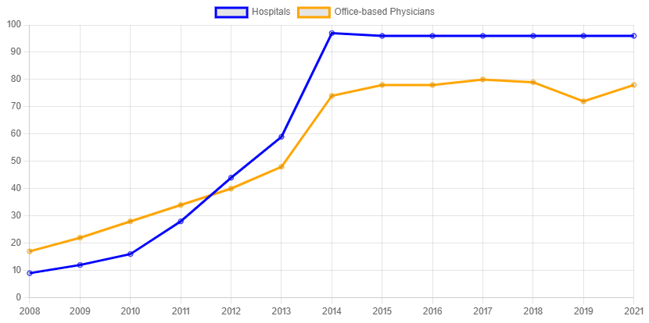
## HIS Components
EMR Adoption -
https://www.healthit.gov/sites/default/files/2022-03/chart.PNG

Slide 35
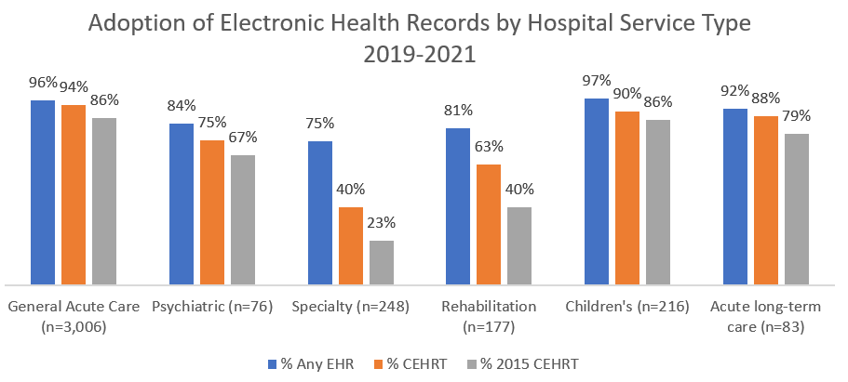
## HIS Components
EMR Adoption – Where gaps still exist -> Specialty + Rehab
https://www.healthit.gov/sites/default/files/2022-10/ehr-adoption-for-congressional-report-and-blogpost.png

Slide 36
## HIS Components
**Patient Portals**
- Personal Health Record Systems (PHR):
- MyChart (EPIC)
- MyHealth (CERNER)
- Usually come with EMR/EHR otherwise will be add-on, custom...
- Stanford MyHealth (not cerner but has same name) - https://myhealth.stanfordhealthcare.org
- Case study of BUILD vs BUY (future SDLC topics)
- https://365.himss.org/sites/himss365/files/365/handouts/552564121/handout-29.pdf

Slide 37
## HIS Components
- **Monitoring and Engagement**
- Remote Patient Monitoring: RPM
- traditional: Fitbit, Apple Watch, etc.
- non-traditional: remote patient monitoring devices
- Customer Relationahip Managers: CRMs
- non-traditional; SalesForce
- issues:
- coding / billing (CPT codes)
- patient engagement
- reviews:
- https://www.ncbi.nlm.nih.gov/pmc/articles/PMC5240011/
- https://www.ncbi.nlm.nih.gov/pmc/articles/PMC9673001/
- https://www.ncbi.nlm.nih.gov/pmc/articles/PMC8388293/

Slide 38
## HIS Components
- **Medications and Labs**
- E-prescribing - Surescripts
- Pharmacy Benefit Managers (PBMs) - CVS, Express Scripts, OptumRx
- Be be involed in drug pricing, formulary, payment processing, providing some clinical services, data analysis
- Lab Information Systems (LIS) - Sunquest, Cerner, Epic
- Focus on lab workflow, data management, and data analysis for labs

Slide 39
## HIS Components
- **Billing and Revenue**
- Revenue Cycling Management (RCM): involved with billing, claims, insurance, etc.
- Epic, Cerner, Allscripts, AthenaHealth, eClinicalWorks, NextGen, etc.
- They all have their own RCM tools
- Claims/Insurance - Utilization Management (UM)

Slide 40
## HIS Components
- **Supply Chain and Clinical Trials**
- Supply Chain Management (SCM)
- Inventory management, purchasing, and distribution
- SAP, Oracle, IQVIA, Parexel
- CROs / clinical research organizations

Slide 41
## HIS Components
- **Analytics**
- Business Intelligence (BI) and Data Warehousing (DW)
- Tableau, PowerBI
- Snowflake, Redshift, BigQuery (cloud based)

Slide 42
## HIS Components
Any many more….
Review article:
[Best RCM Tools]
(https://www.beckershospitalreview.com/finance/the-31-best-rcm-tools-per-klas.html

Slide 43
## Financial Burden of HIS on systems
- Average hospital IT operating expense: 8.4 million
- Average hospital IT operating expense as a percentage of total operating expense: 3-4%
- Hospitals with 25 beds or fewer spend less than $1 million for IT solutions, compared to hospitals with more than 250 beds, which spend nearly $29 million on average.
- Hospitals with more than 250 beds also had the highest average annual increase in IT expenses since 2017 at more than 6%. Hospitals with 250 or fewer beds had average IT expense increases of less than 5%.
https://www.definitivehc.com/resources/healthcare-insights/average-it-expenses-us-hospitals

Slide 44
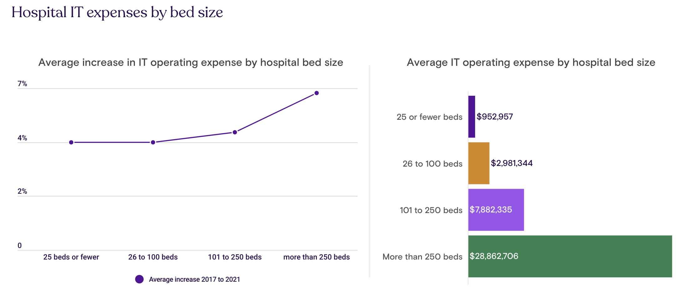

Slide 45
Health information systems
are hard to build

Slide 46
## Current Challenges in HIS
A. Design and Development
1. Risk assessment tools
2. UI design standards
3. Software safety in networks
4. Unambiguous patient ID

Slide 47
## Current Challenges in HIS
B. Implementation and Use
5. Decision support for safety
6. IT transition management

Slide 48
## Current Challenges in HIS
C. Monitoring and Optimization
7. Automated system monitoring
8. Cultural and legal frameworks
9. Patient-centric Health IT safety

Slide 49
Key Issues: manual, lack of integrations, ahead of its time by 10 years
https://googleblog.blogspot.com/2010/09/google-health-update.html
https://www.mobihealthnews.com/11480/10-reasons-why-google-health-failed

Slide 50
https://www.cnbc.com/2021/01/04/haven-the-amazon-berkshire-jpmorgan-venture-to-disrupt-healthcare-is-disbanding-after-3-years.html

Slide 51
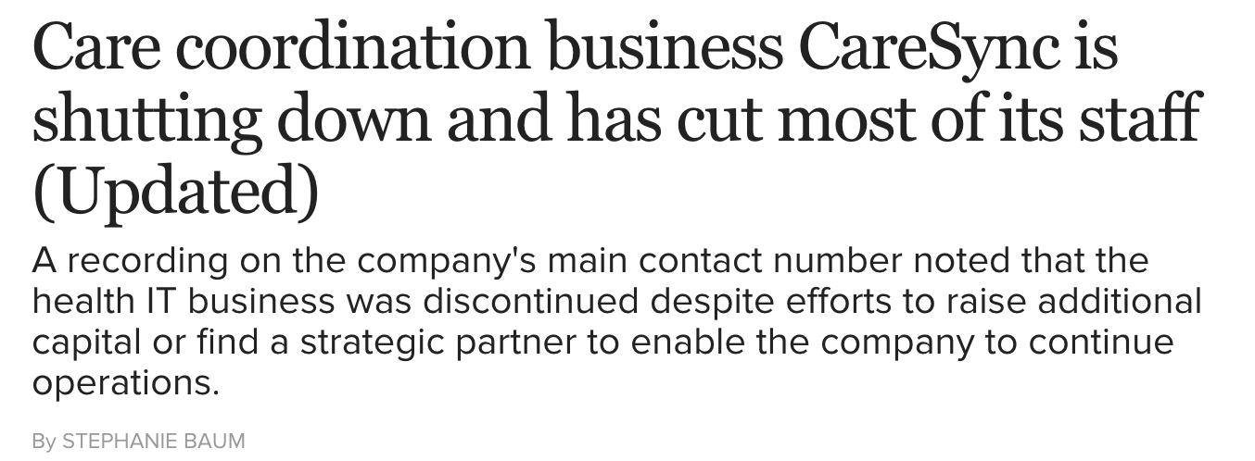
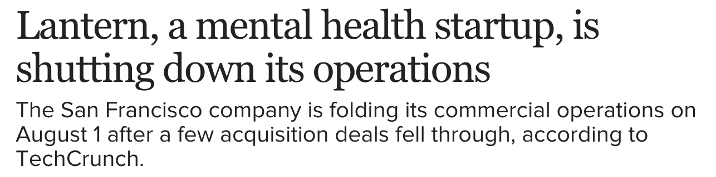

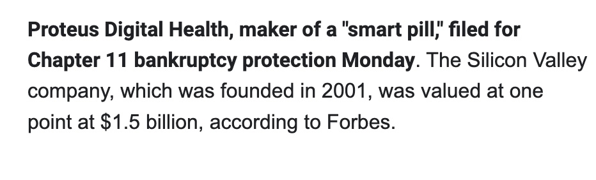

Slide 52
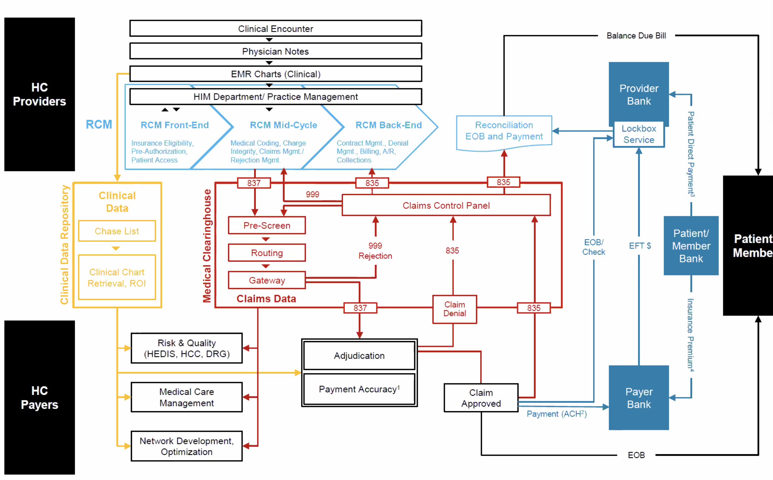
A piece of the complexity….healthcare business logic between providers, patients, and payers for RCM

Slide 53
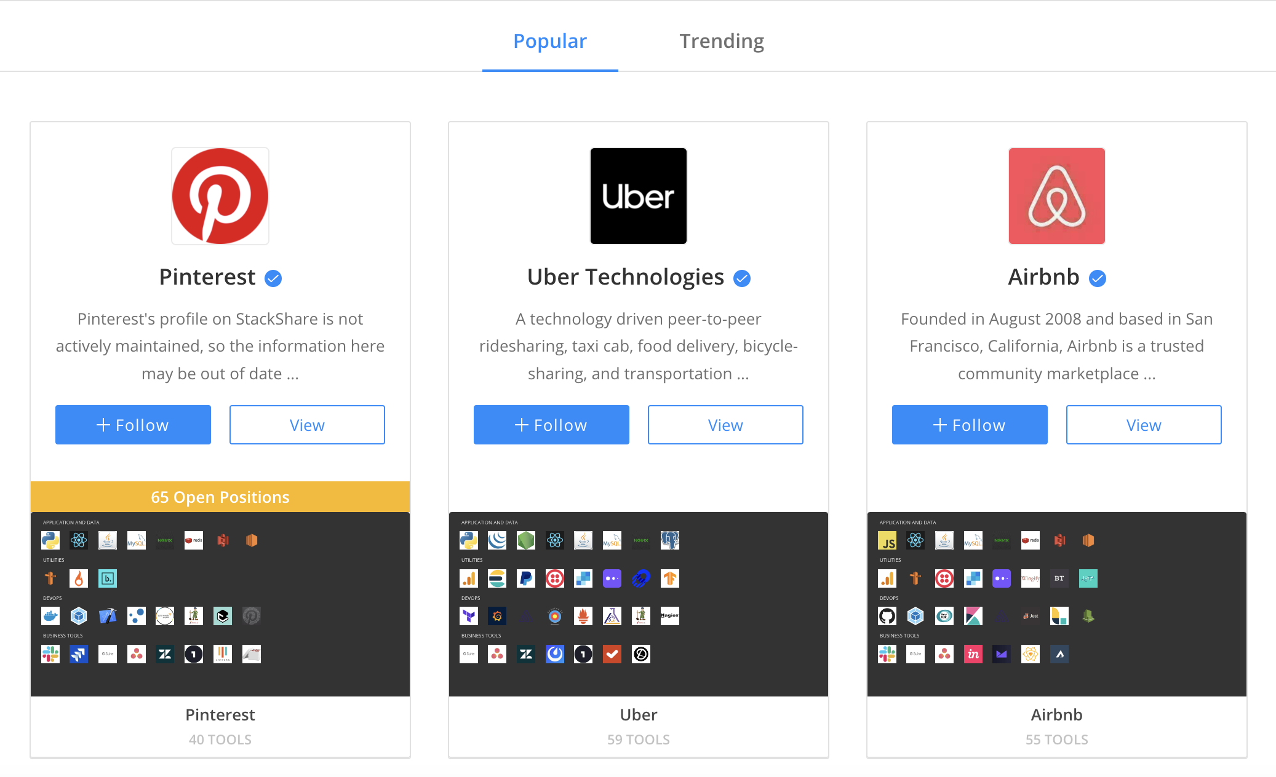
## Key Terms and Roles
- **Technology Stack**
- [StackShare](https://stackshare.io/stacks)

Slide 54

Health Information Management Systems (HIMS) Demos
https://www.onpatient.com/
Free patient portal
https://openmrs.org/
https://www.open-emr.org/demo/
Free EMR / open source

Slide 55
Health Information Technology (HIT) Demos
https://aws.amazon.com/comprehend/medical/
AWS
https://aws.amazon.com/healthlake/
GCP
https://cloud.google.com/healthcare
MSF
https://azure.microsoft.com/en-us/services/azure-api-for-fhir/
https://docs.microsoft.com/en-us/azure/cognitive-services/text-analytics/how-tos/text-analytics-for-health?tabs=ner
https://www.microsoft.com/en-us/research/project/health-bot/

